Slide 1
ARKBot Assembly

Slide 2
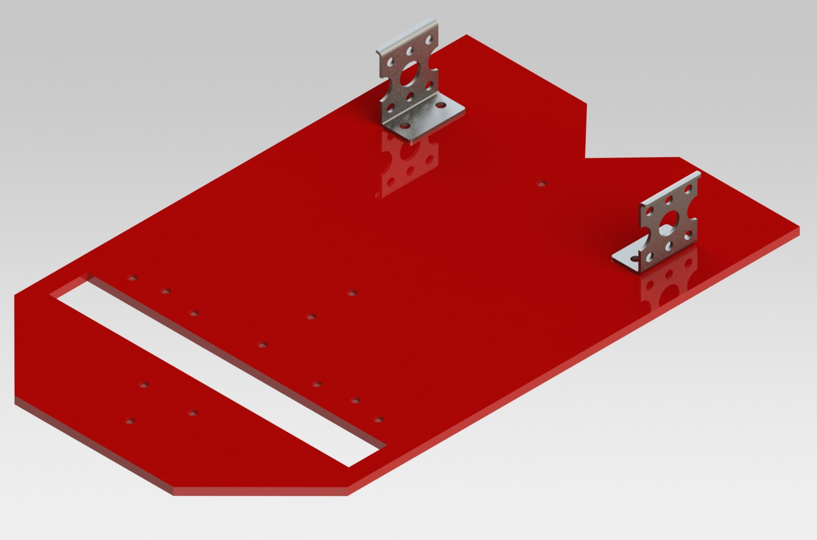
Placing the L-Clamp

Slide 3
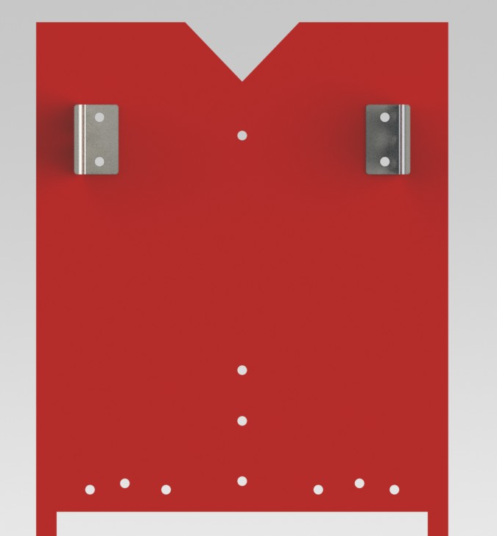
Placing the L-Clamp

Slide 4
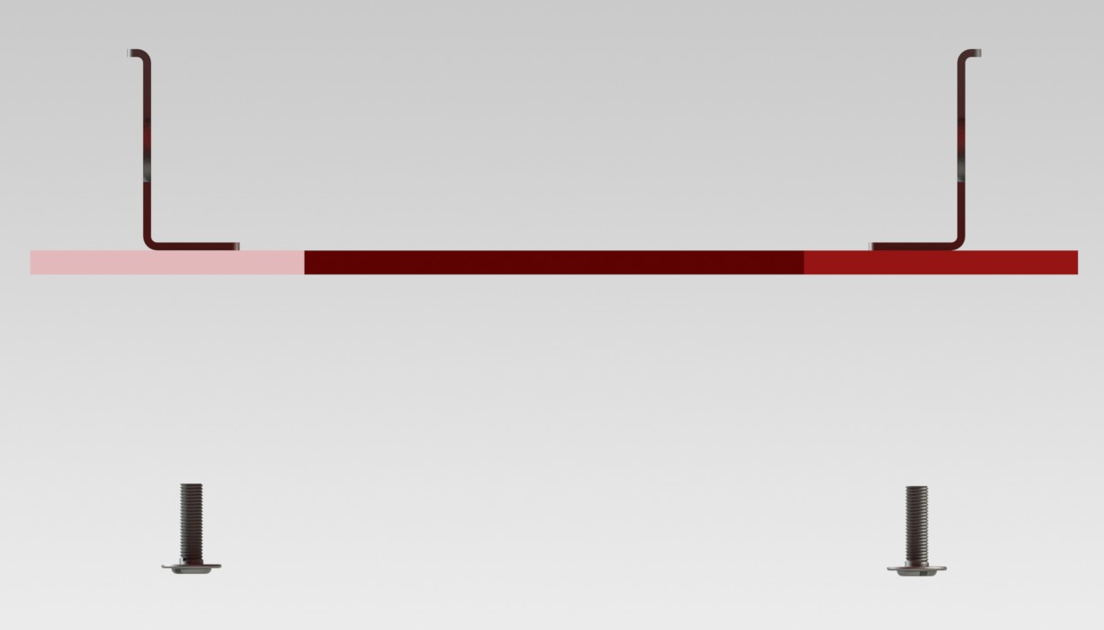
Placing the L-Clamp

Slide 5
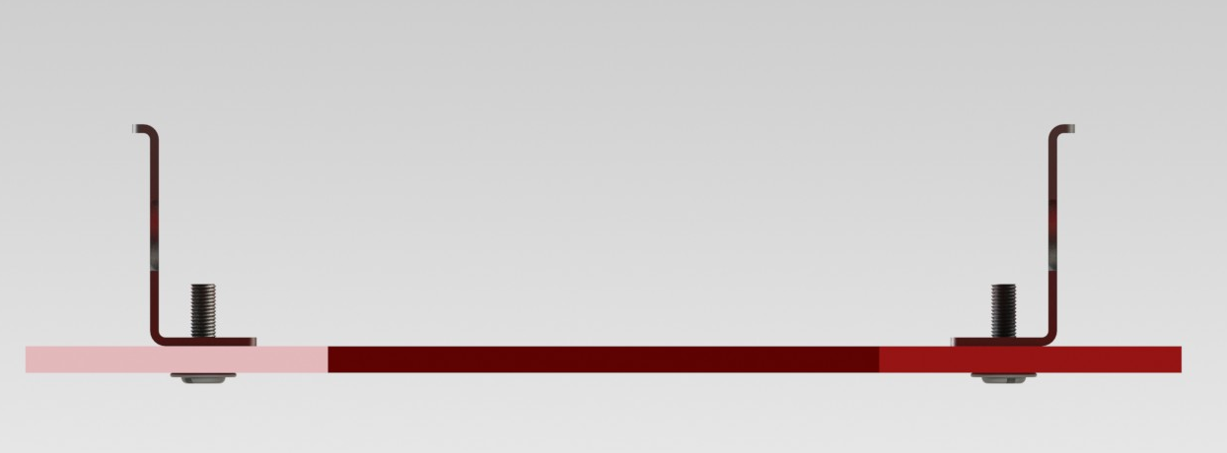
Placing the L-Clamp

Slide 6
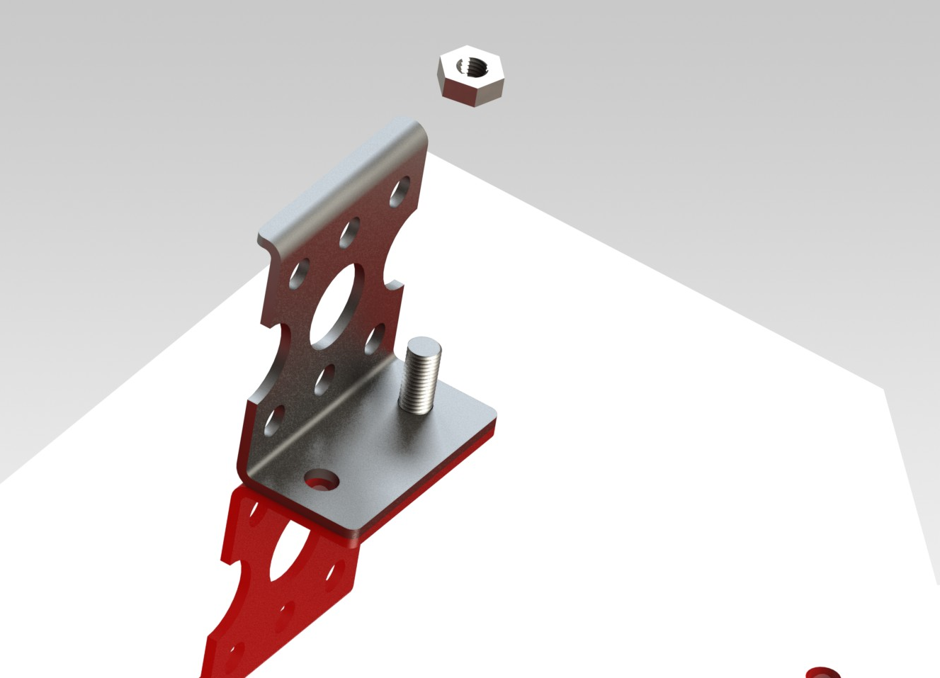
Placing the L-Clamp

Slide 7
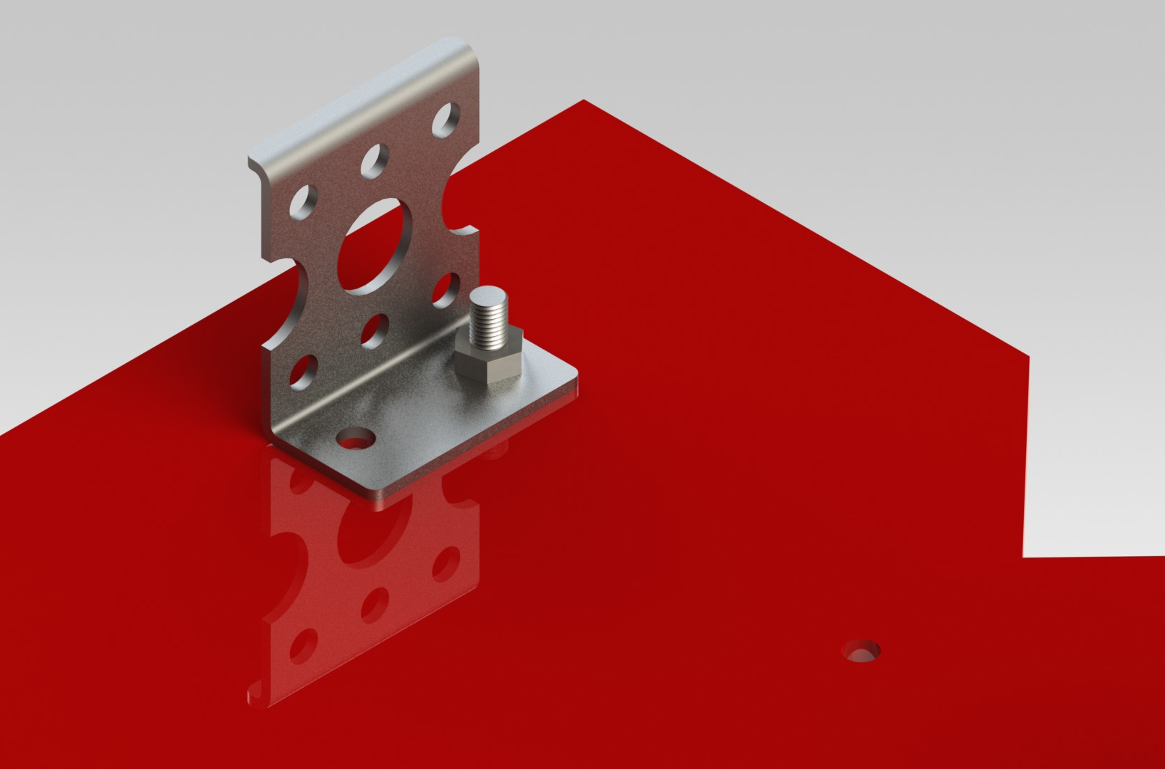
Placing the L-Clamp

Slide 8
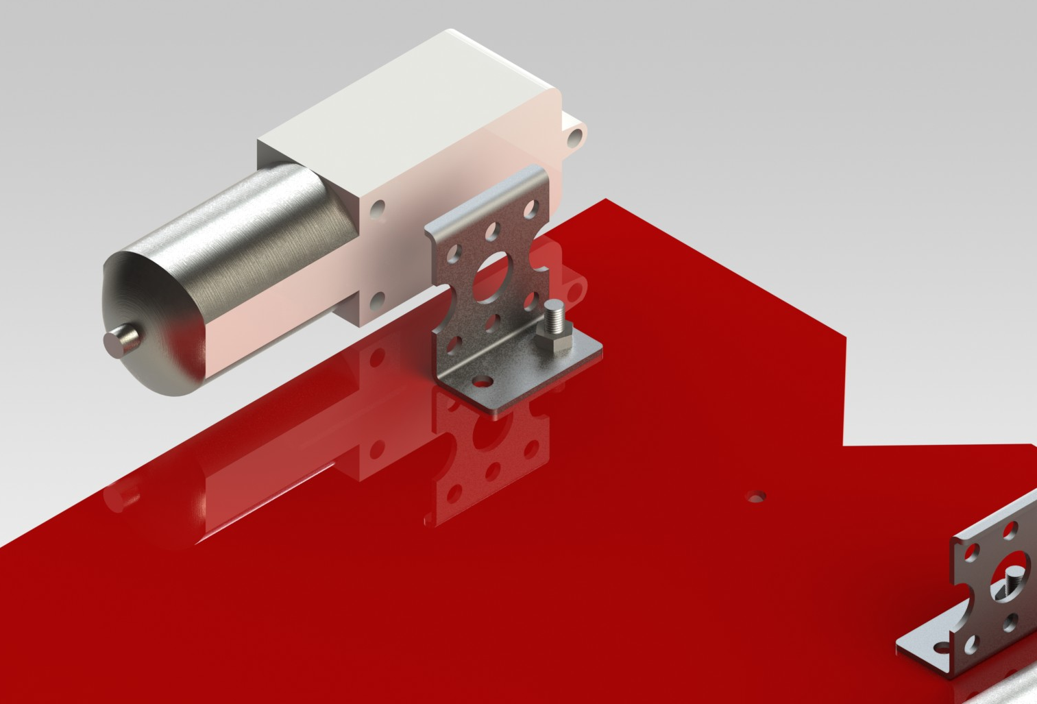
Placing the Motors

Slide 9
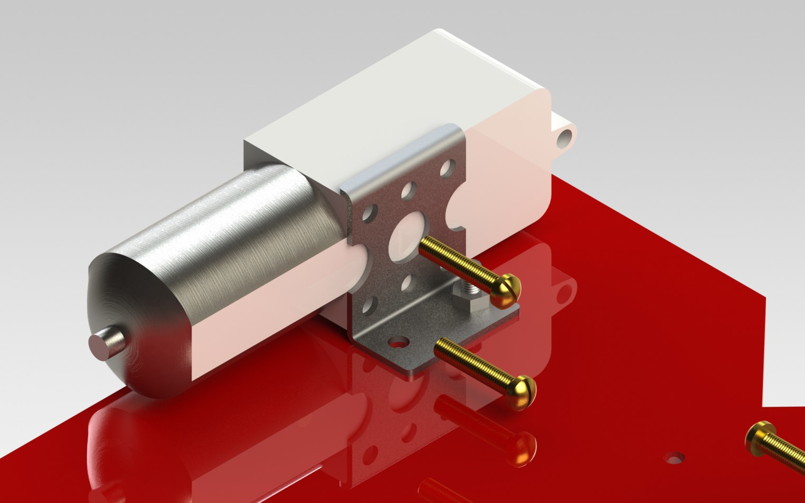
Placing the Motors

Slide 10
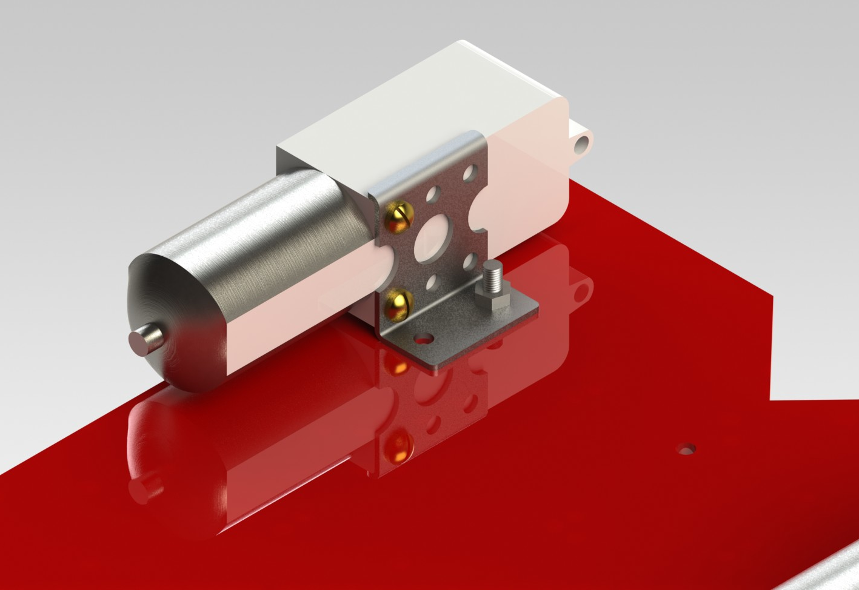
Placing the Motors

Slide 11
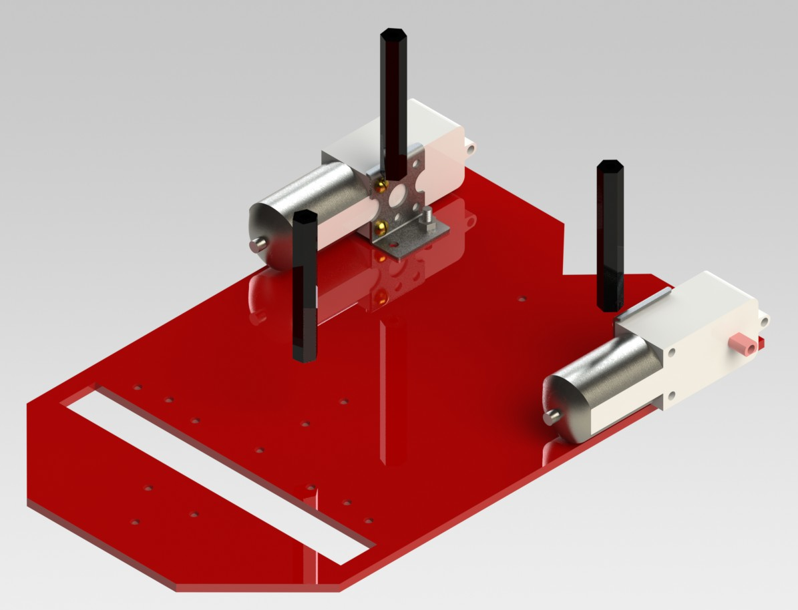
Placing the Spacers

Slide 12
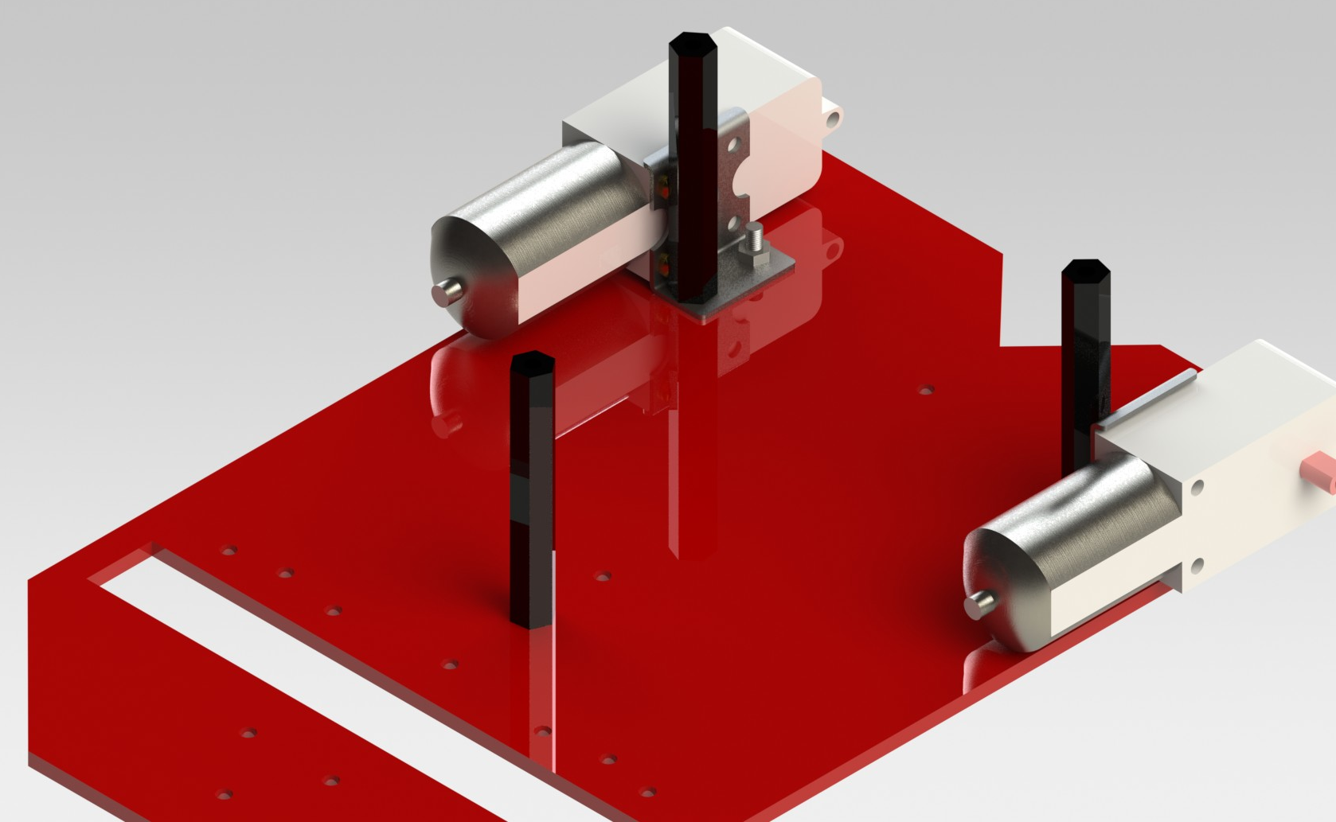
Placing the Motors

Slide 13
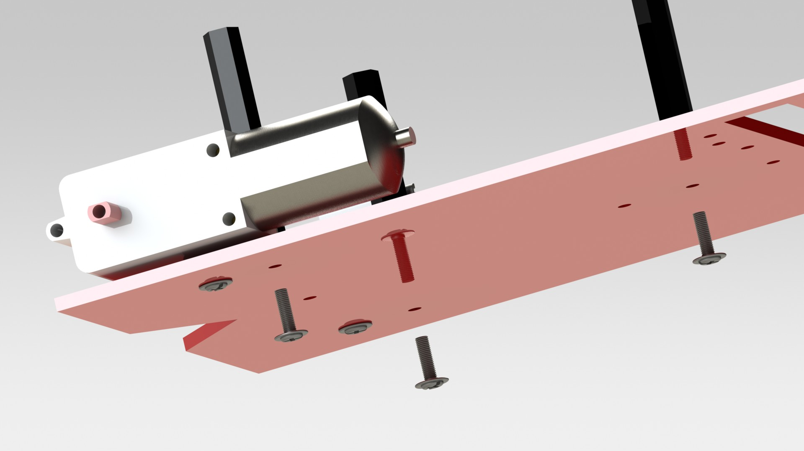
Placing the Motors

Slide 14
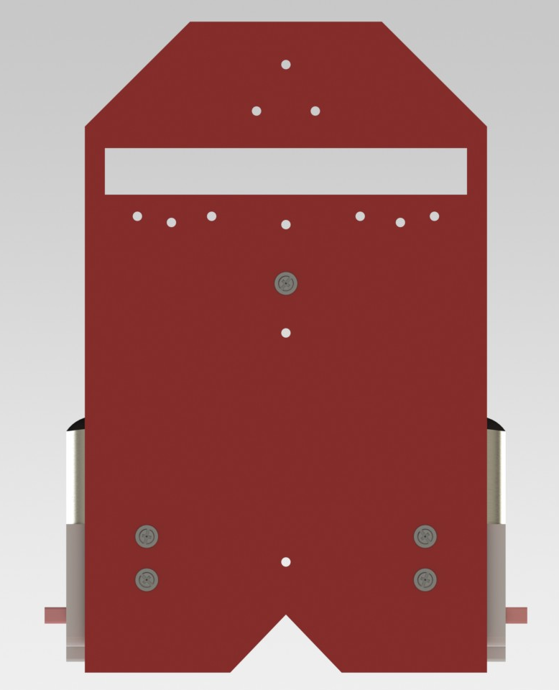
Placing the Motors

Slide 15
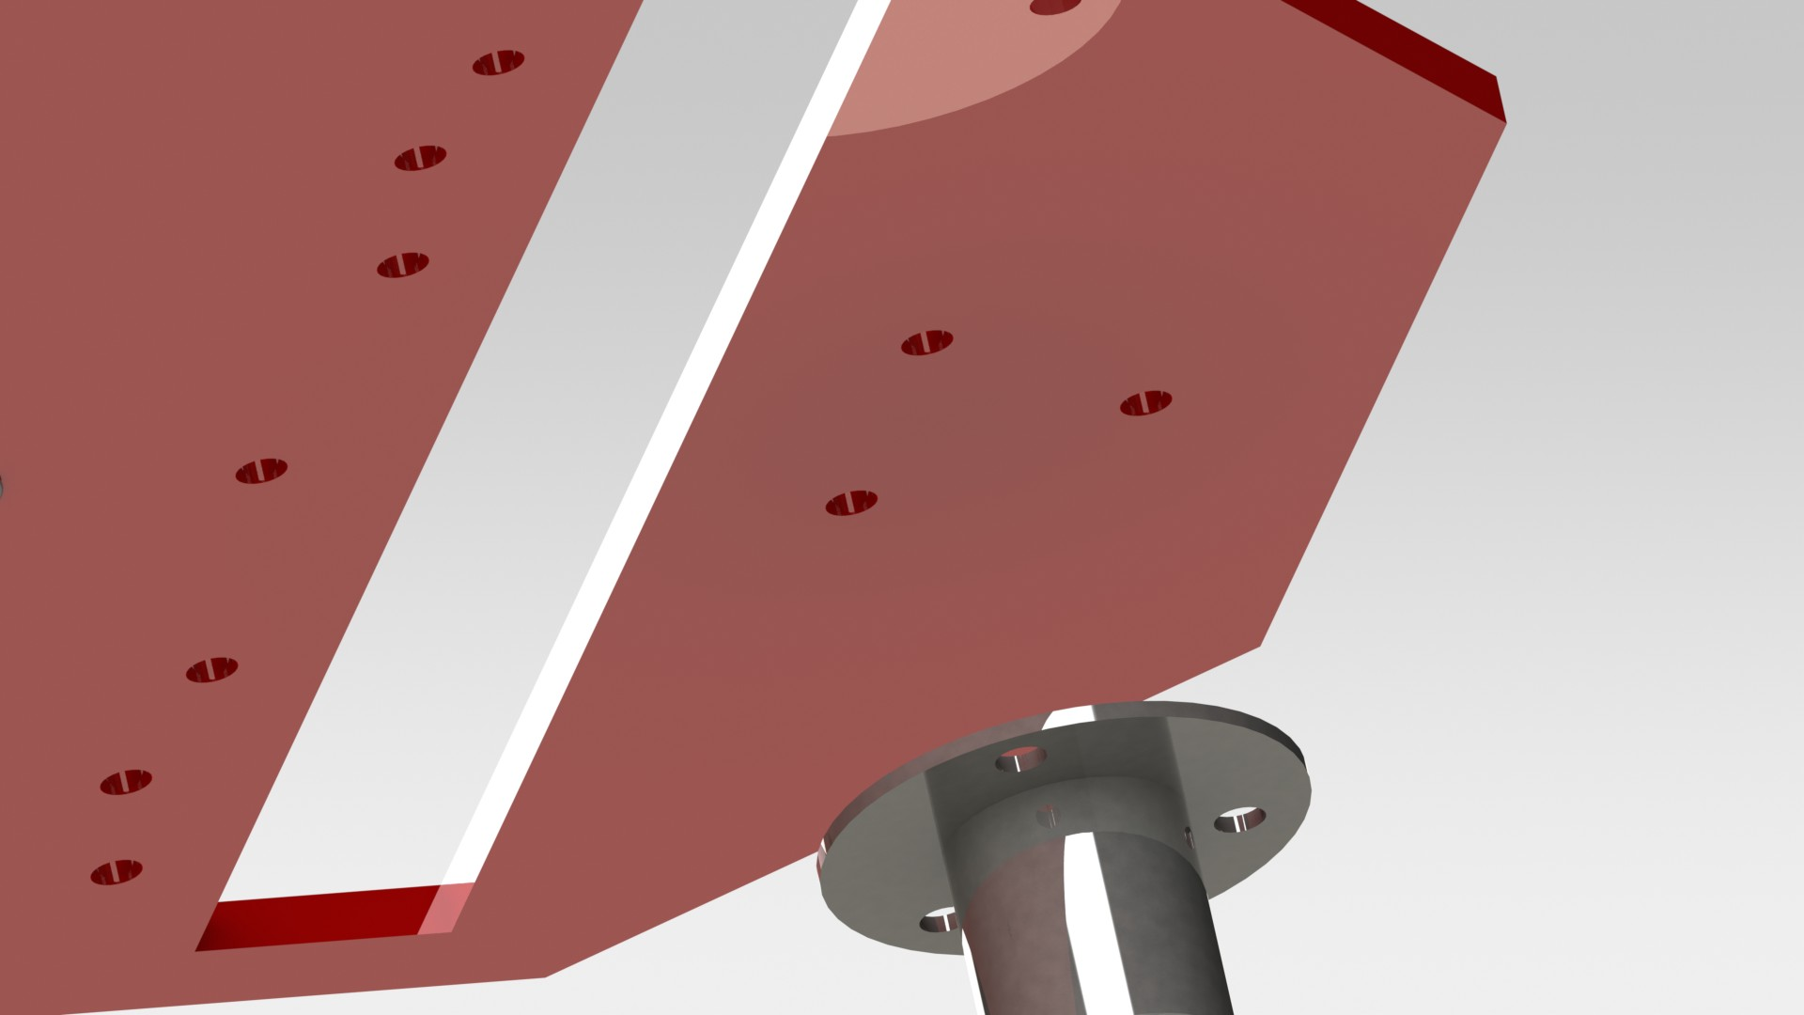
Placing the Castor Wheels

Slide 16
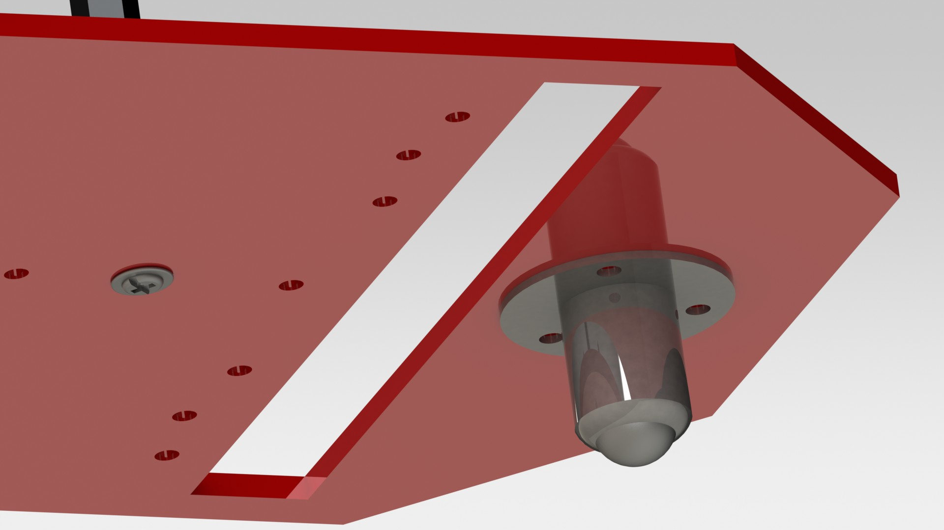
Placing the Castor Wheels

Slide 17
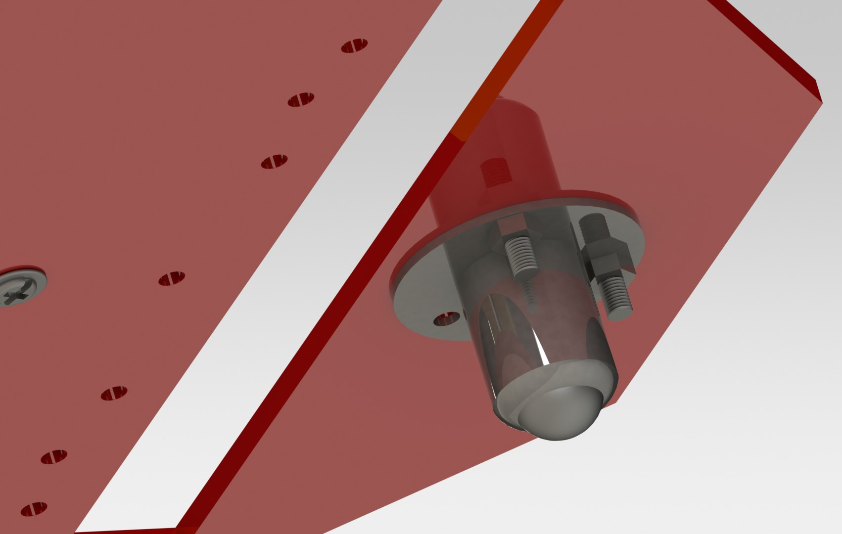
Placing the Castor Wheels

Slide 18
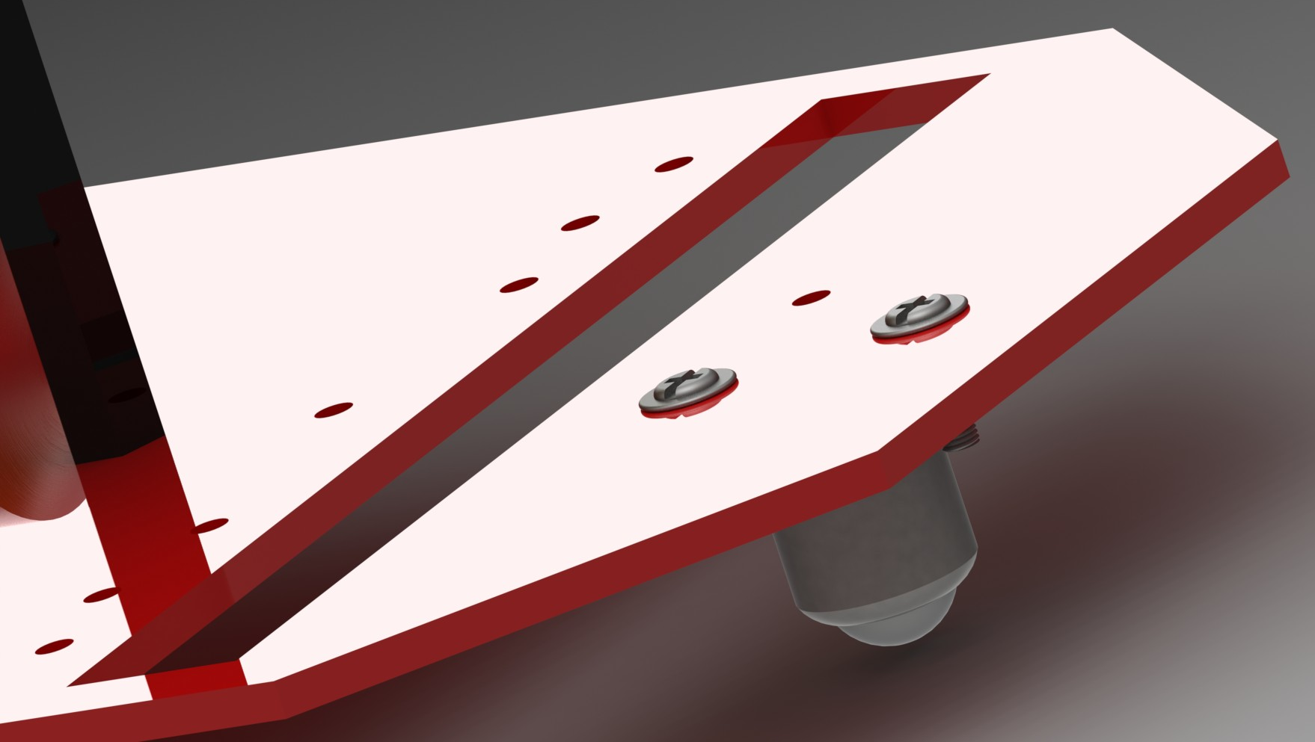
Placing the Castor Wheels

Slide 19
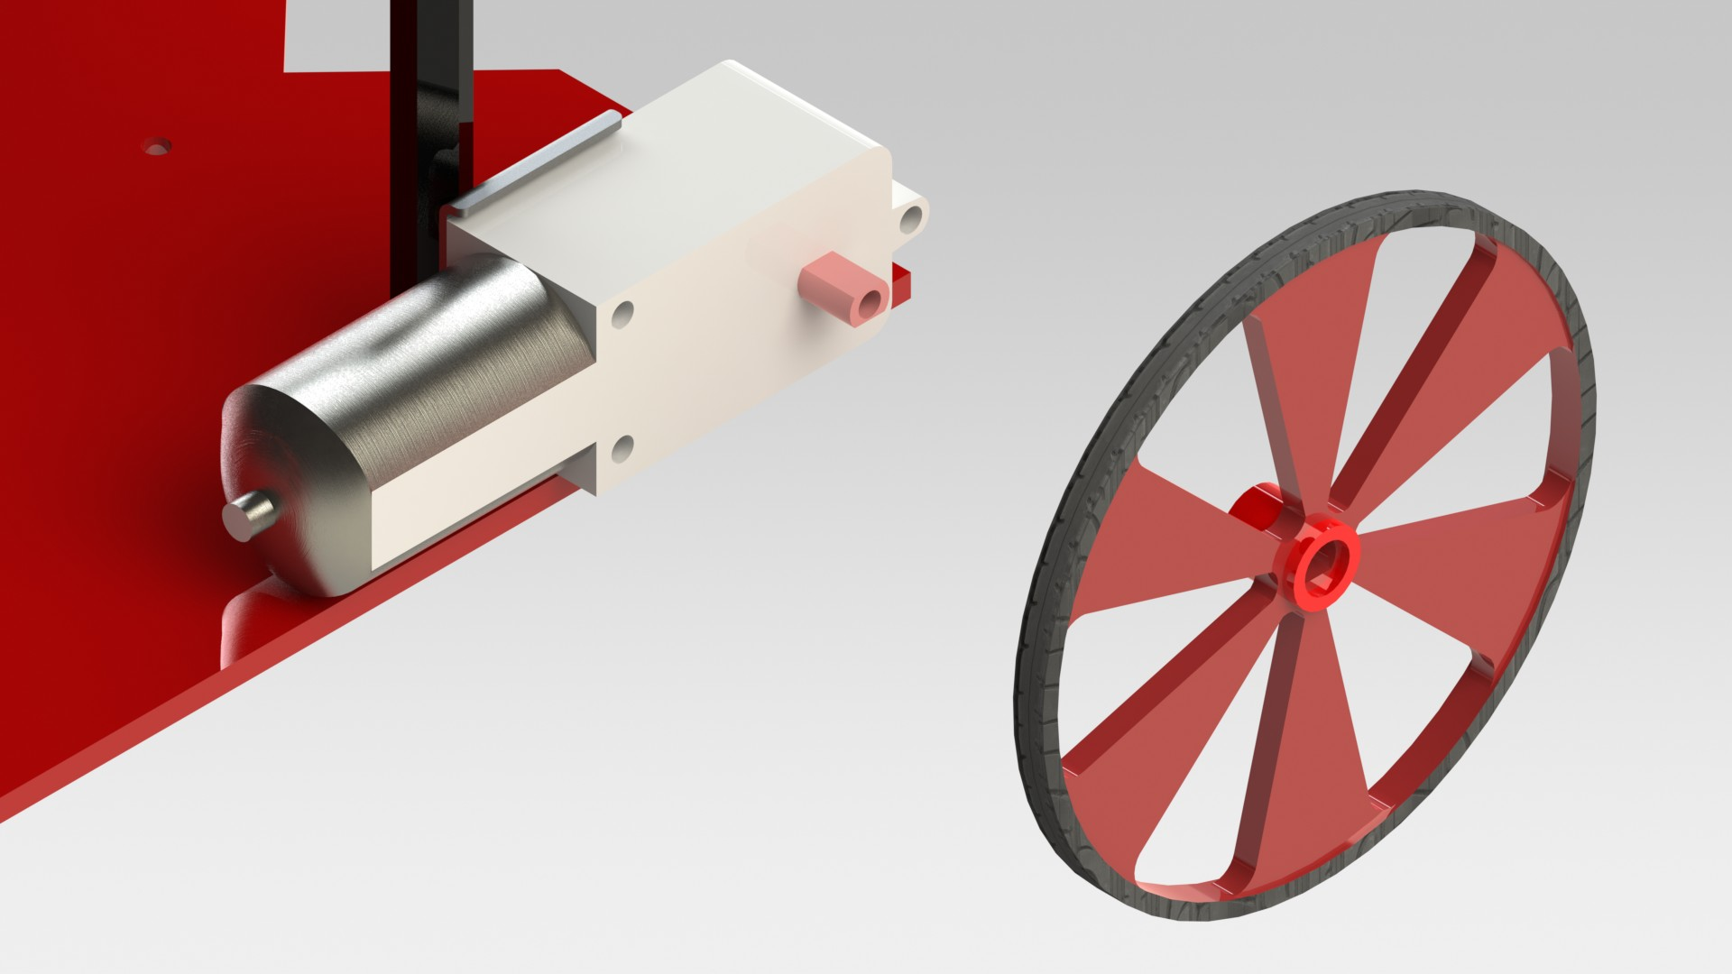
Placing the Wheels

Slide 20
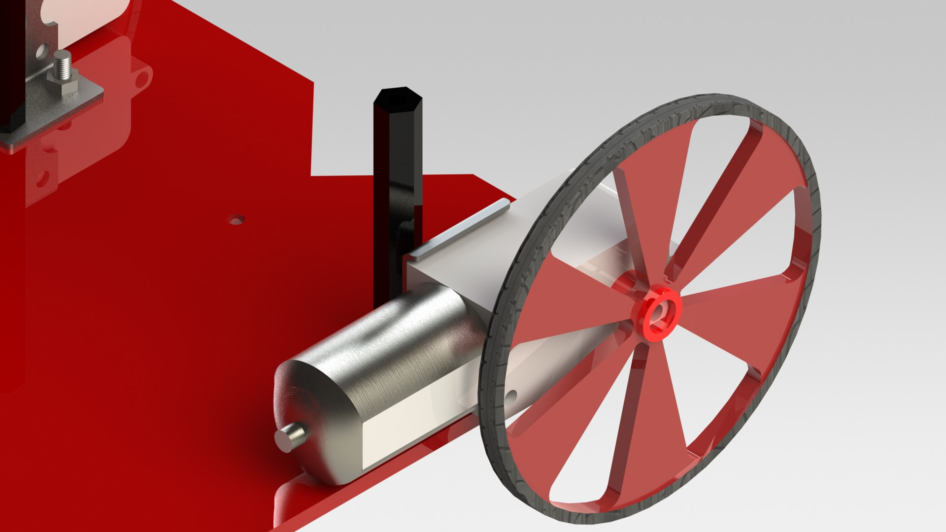
Placing the Wheels

Slide 21
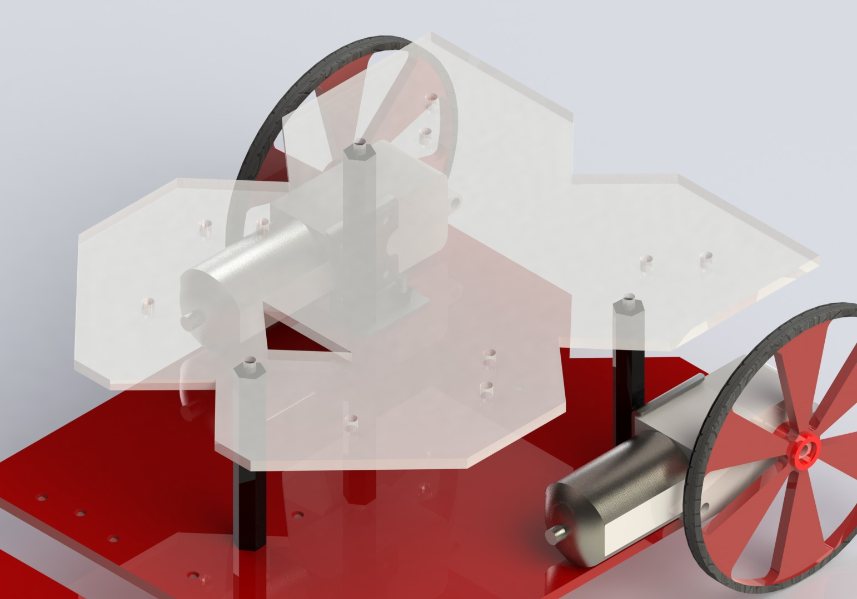
Placing the Top Plate

Slide 22
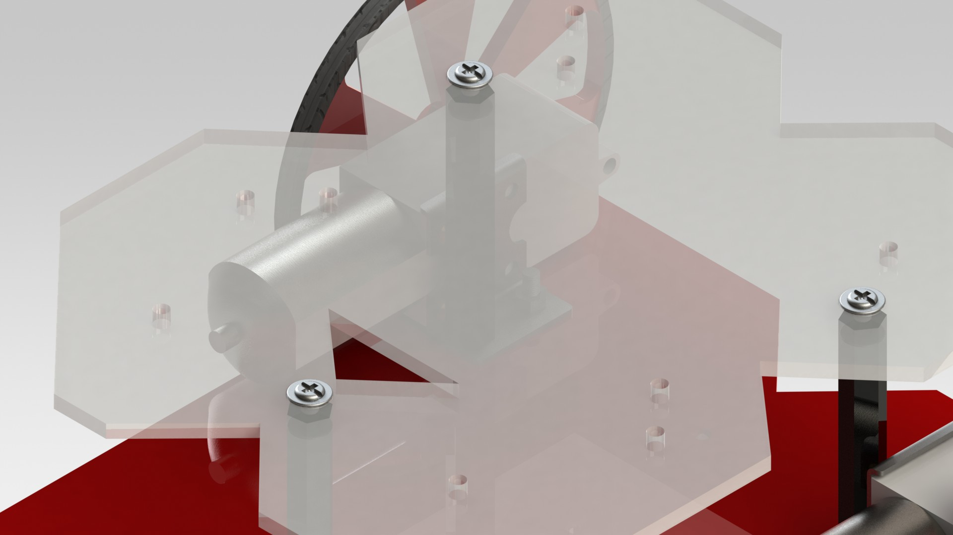
Placing the Top Plate

Slide 23
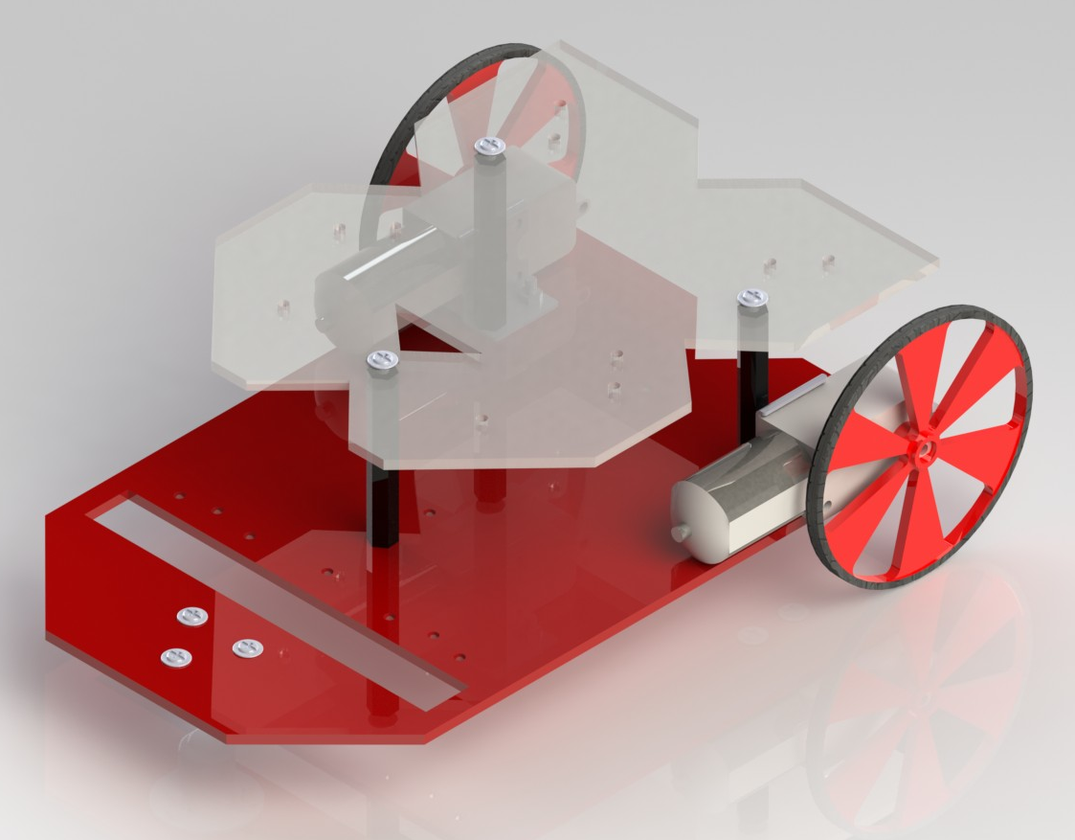
Final Bot

